Slide 1
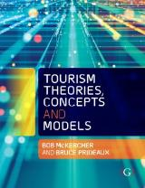

Chapter 16: Tourism Planning

Slide 2
Learning Objectives
Describe the difference between planning and policy
Identify and describe the scales of planning
Explain the need to consider new approaches to planning in the future

Slide 3
Tourism planning
Dredge and Jennings (2007) define planning as a “strategic activity comprising a number of stages that lead to the determination of a course of action to meet predetermined goals. Planning is concerned with the future; is devoted to acquiring knowledge and identifying appropriate courses of action; is about anticipating change, developing a strategic vision and facilitating political decision making; and is value-laden and political.”
Emerged as a specialised field in the 1960s in response to growing demand for tourism
Governments began to support tourism planning at destination, regional and national levels, generally following a focus on investment incentives, industry organisation and spatial considerations
  Essentially an exercise in matching demand with tourism products.
  Often failed, highlighting the need to be more inclusive
Needs to occur in a policy environment

Slide 4
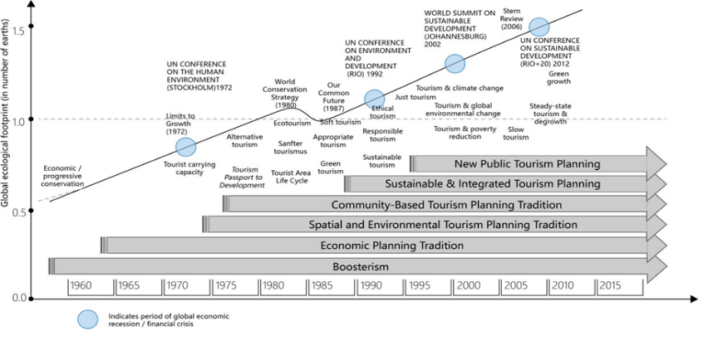
Relationships between planning traditions, key themes, global development milestones and humanity’s global footprint
Source: Hall 2015

Slide 5
Prof Peter Williams talks about tourism policy and planning with multiple stakeholders
https://www.youtube.com/watch?v=qZls-4gwgSw

Slide 6
Planning approaches
Boosterism
Economic
Physical/spatial
Community
Sustainable
(Getz 1987, Hall 2000)

Slide 7
Planning typologies (Dredge and Jenkins 2007)
Industry development planning and policy – use of financial measures and tools such as incentives and tax breaks to strengthen industry capacity
Market planning and policy – promote the development and expansion of markets with the aim of product development and diversification
Spacio-physical destination planning and policy – spatial destination planning, modelling and relationships between attractions, services, origins, transport routes and marketing
Conflict management planning and policy – measures to mitigate the social, cultural, environmental and economic effects of tourism on local destinations.
Communicative tourism planning and policy- establishing collaborative dialogue where multiple stakeholders are involved
Crisis-responsive planning and policy – addressing crises as they emerge and drawing where appropriate from the previous approaches

Slide 8
10 stages of planning (Lew 2007)
Formulation of goals and objectives
Identify a goal (to solve the problem)
Collect background data
Identify guidelines for assessing alternative plan scenarios
Identify alternative plan scenarios, including policies and guidelines to achieve the goals
Assess alternative plans scenarios using pre-defined assessment guidelines
Select the preferred alternative
Implement the plan
Monitor, evaluate, and revise the Implementation
Identify new problems and begin the process again

Slide 9
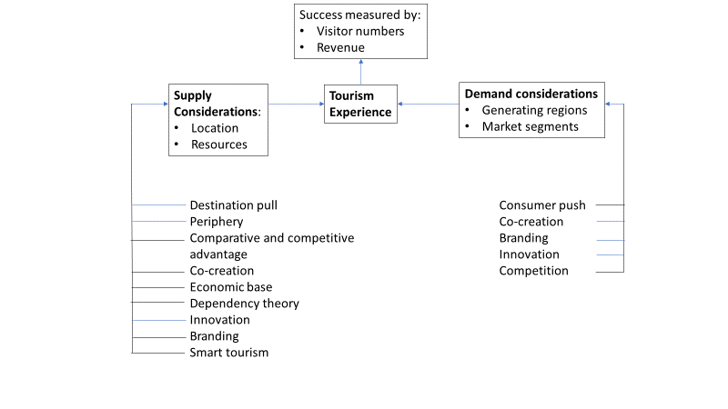
Open architecture approach - Prideaux and Thompson (2021)
Allows various models and theories to be ‘plugged in’, on an ‘as required’ basis, as planning moves through a series of stages

